Slide 1

AUTOMATED TIMETABLE SCHEDULING SYSTEM USING BACKTRACKING ALGORTIHM

Slide 2
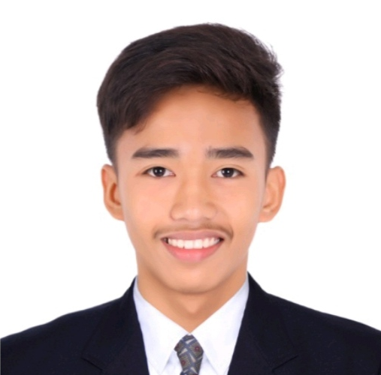
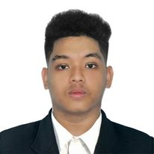
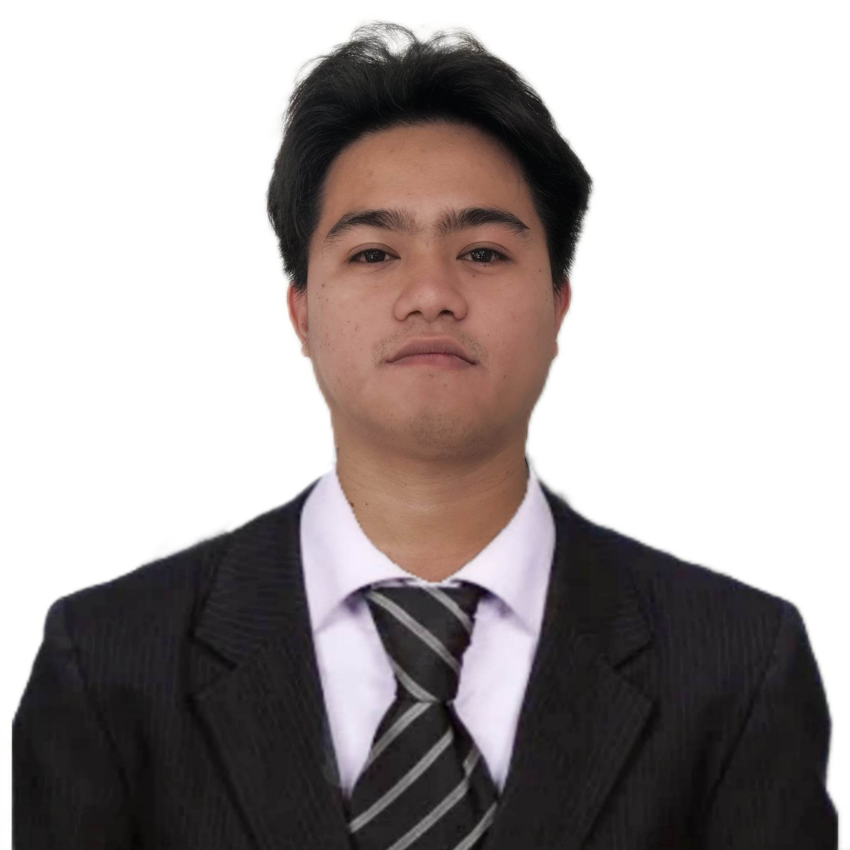
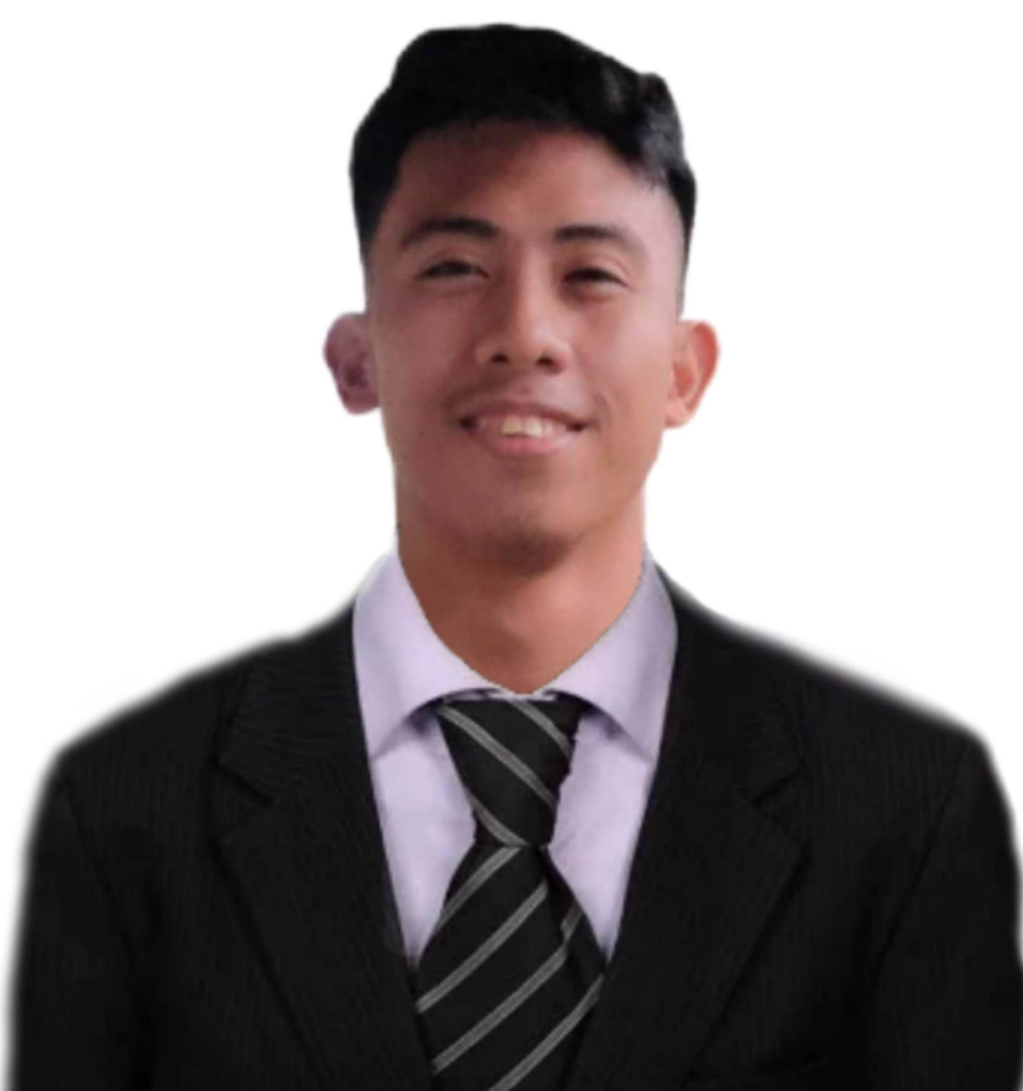
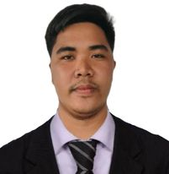
PROPONENTS
Hernando Jr. J. Costelo APPLICATION DEVELOPER
BSCS 402 -E
Michelle Emmanuel S. Gaetos PROJECT LEADER
BSCS 402 -E
Johnuel M. Javier SYSTEM ANALYST
BSCS 402 -E
Ren Russel E. Lavilla UI/UX
BSCS 402 -E
Lester D. Quijano QUALITY ASSURANCE
BSCS 402 -E

Slide 3
ADVISER/TECHNICAL CRITIC
NO IMAGE
NO IMAGE
Mr. Jose Karlo E. Nabablit Adviser
Mr. Raven M. Topacio
Technical Critic

Slide 4


Short Description of Expected Technology

Slide 5





AUTOMATED TIMETABLE SCHEDULING SYSTEM
Web-based System
Automated
Course Timetable
Dynamic

Slide 6

AUTOMATED TIMETABLE SCHEDULING SYSTEM
Teacher
Rooms
Students
Generation of Reports

Slide 7

RATIONALE

Slide 8

Cavite State University CCAT Campus

Slide 9




Manual Scheduling Problems:
TIME SPENT
DATA
Security
Storage
UPDATE
Reusability
CONFLICTS

Slide 10
OBJECTIVE OF THE STUDY

Slide 11
1. Document and analyze the existing process of scheduling classes
5. Create an implementation plan for the deployment of the software.
2. design and develop a web application that will automate the generation of class schedules.
The general objective of the study is to develop a dynamic web-based scheduling system that will be used to eliminate the manual scheduling process of Cavite State University-CCAT Campus.
4. Evaluate the system using modified ISO-IEC 25101.
3. test the reliability and functionality of the generated output; and

Slide 12
GENERAL OBJECTVE
The general objective of the study is to develop a dynamic web-based scheduling system that will be used to eliminate the manual scheduling process of Cavite State University-CCAT Campus.

Slide 13
1. Document and analyze the existing process of scheduling classes
5. Create an implementation plan for the deployment of the software.
2. design and develop a web application that will automate the generation of class schedules.
The general objective of the study is to develop a dynamic web-based scheduling system that will be used to eliminate the manual scheduling process of Cavite State University-CCAT Campus.
4. Evaluate the system using modified ISO-IEC 25101.
3. test the reliability and functionality of the generated output; and

Slide 14
1. Document and analyze the existing process of scheduling classes
SPECIFIC OBJECTIVE#1

Slide 15
1. Document and analyze the existing process of scheduling classes
5. Create an implementation plan for the deployment of the software.
2. design and develop a web application that will automate the generation of class schedules.
The general objective of the study is to develop a dynamic web-based scheduling system that will be used to eliminate the manual scheduling process of Cavite State University-CCAT Campus.
4. Evaluate the system using modified ISO-IEC 25101.
3. test the reliability and functionality of the generated output; and

Slide 16
2. design and develop a web application that will automate the generation of class schedules.
SPECIFIC OBJECTIVE#2

Slide 17
1. Document and analyze the existing process of scheduling classes
5. Create an implementation plan for the deployment of the software.
2. design and develop a web application that will automate the generation of class schedules.
The general objective of the study is to develop a dynamic web-based scheduling system that will be used to eliminate the manual scheduling process of Cavite State University-CCAT Campus.
4. Evaluate the system using modified ISO-IEC 25101.
3. test the reliability and functionality of the generated output; and

Slide 18
3. test the reliability and functionality of the generated output; and
SPECIFIC OBJECTIVE#3

Slide 19
1. Document and analyze the existing process of scheduling classes
5. Create an implementation plan for the deployment of the software.
2. design and develop a web application that will automate the generation of class schedules.
The general objective of the study is to develop a dynamic web-based scheduling system that will be used to eliminate the manual scheduling process of Cavite State University-CCAT Campus.
4. Evaluate the system using modified ISO-IEC 25101.
3. test the reliability and functionality of the generated output; and

Slide 20
4. Evaluate the system using modified ISO-IEC 25101.
SPECIFIC OBJECTIVE#4

Slide 21
1. Document and analyze the existing process of scheduling classes
5. Create an implementation plan for the deployment of the software.
2. design and develop a web application that will automate the generation of class schedules.
The general objective of the study is to develop a dynamic web-based scheduling system that will be used to eliminate the manual scheduling process of Cavite State University-CCAT Campus.
4. Evaluate the system using modified ISO-IEC 25101.
3. test the reliability and functionality of the generated output; and

Slide 22
5. Create an implementation plan for the deployment of the software.
SPECIFIC OBJECTIVE#5

Slide 23
1. Document and analyze the existing process of scheduling classes
5. Create an implementation plan for the deployment of the software.
2. design and develop a web application that will automate the generation of class schedules.
The general objective of the study is to develop a dynamic web-based scheduling system that will be used to eliminate the manual scheduling process of Cavite State University-CCAT Campus.
4. Evaluate the system using modified ISO-IEC 25101.
3. test the reliability and functionality of the generated output; and

Slide 24

SCOPE AND LIMITATION

Slide 25

SCOPE
Cavite State University CCAT Campus
Web-based System
DYNAMIC
AUTOMATES

Slide 26

LIMITATION
MULTIPLE USERS

Slide 27

TABLE OF COMPARISON

Slide 28
Features | Automated College Timetable Generator | Bohol State Island University Automated Scheduling System | Web based Course Scheduling System using Greedy Algorithm | Intelligent Timetable Generator using Genetic Algorithm | Timetable Generator using Genetic algorithm. | Automated Timetable Scheduling System using Genetic Algorithm
1. Generation of Reports
2. Manual Update
3. Admin Dashboard
4. Archive of schedules

Slide 29


CONCEPTUAL FRAMEWORK
&
SYSTEM ANALYSIS AND DESIGN

Slide 30







INPUT
Background/Data
Knowledge
Hardware and Software
PROCESS
Requirement Analysis Phase
Prototype Cycle Phase
Developing and Testing Phase
Deployment Phase

Slide 31

OUTPUT
AUTOMATED TIMETABLE SCHEDULING SYSTEM

Slide 32

WIREFRAME

Slide 33
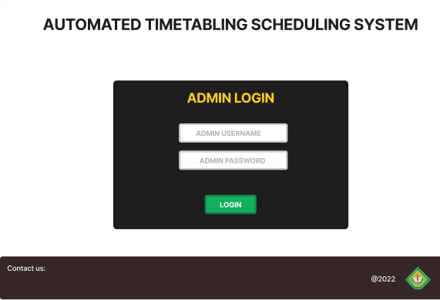
LOGIN PAGE

Slide 34
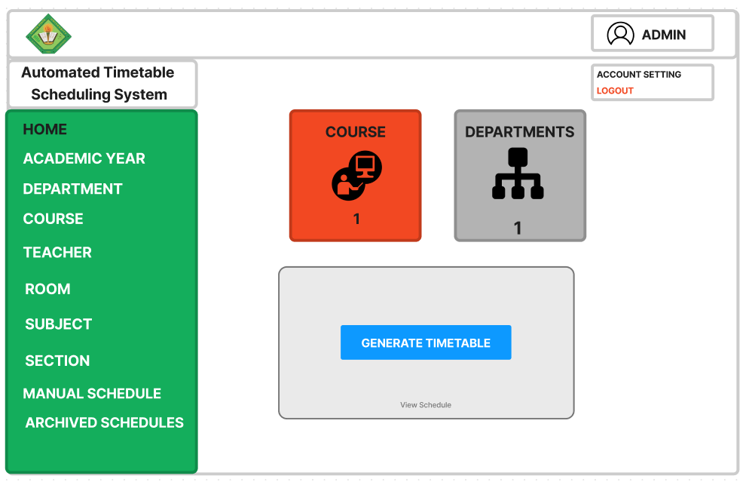
ADMIN DASHBOARD

Slide 35
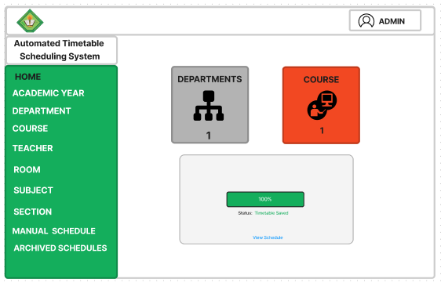
ADMIN DASHBOARD

Slide 36
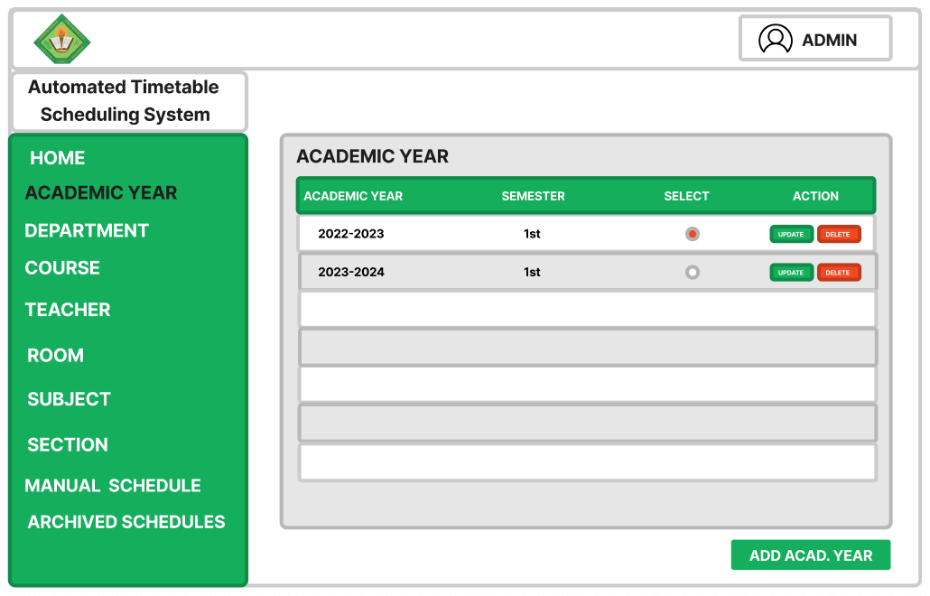
ACADEMIC YEAR PAGE

Slide 37
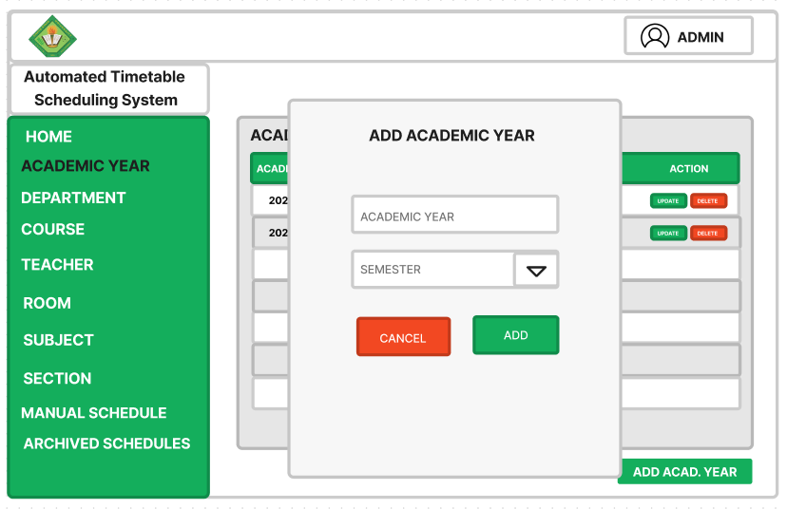
ADD ACADEMIC YEAR PAGE

Slide 38
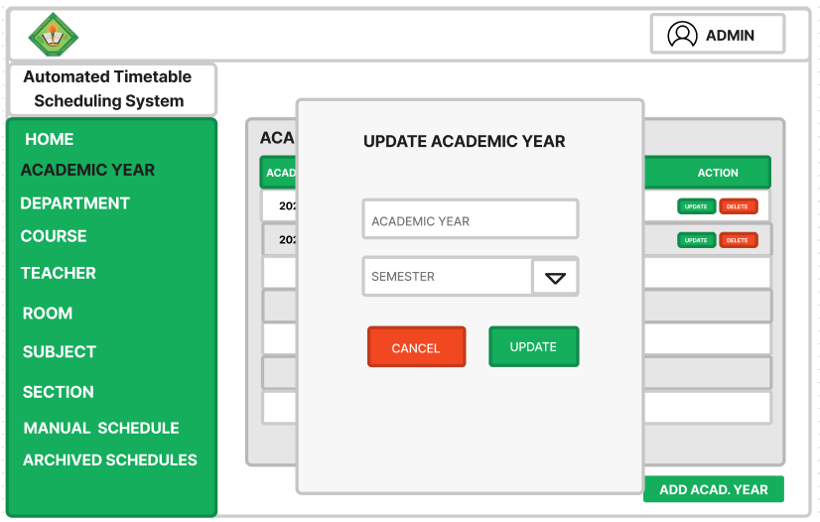
UPDATE ACADEMIC YEAR PAGE

Slide 39
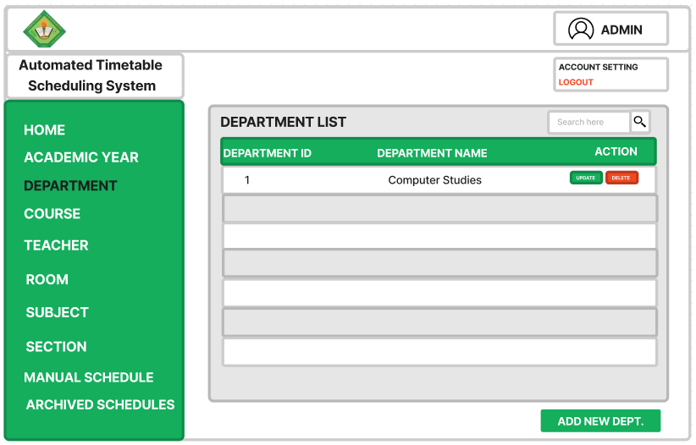
DEPARTMENT LIST PAGE

Slide 40
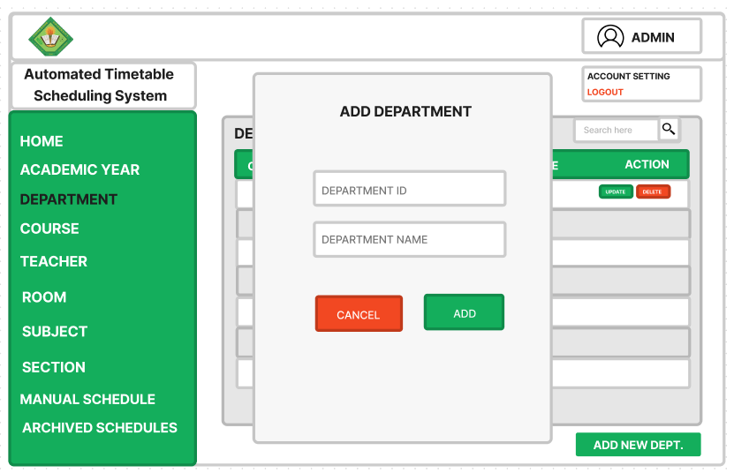
ADD DEPARTMENT PAGE

Slide 41
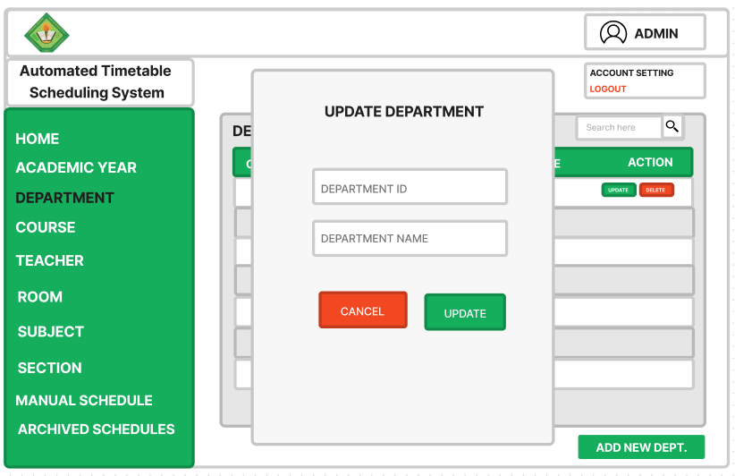
UPDATE DEPARTMENT PAGE

Slide 42
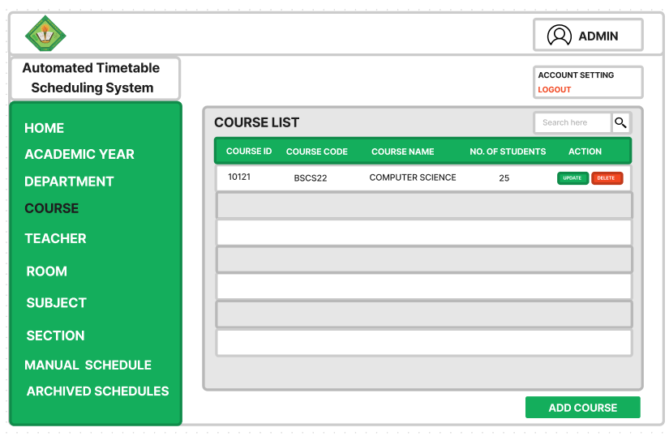
COURSE LIST PAGE

Slide 43
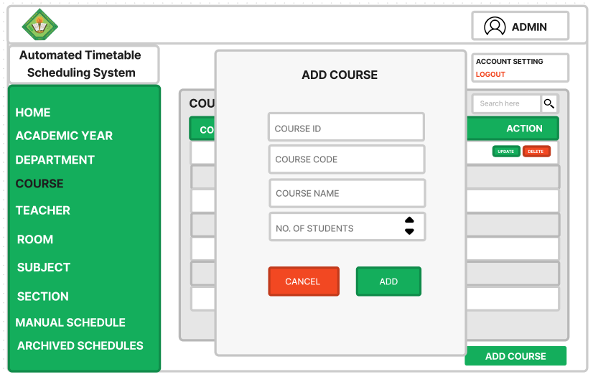
ADD COURSE PAGE

Slide 44
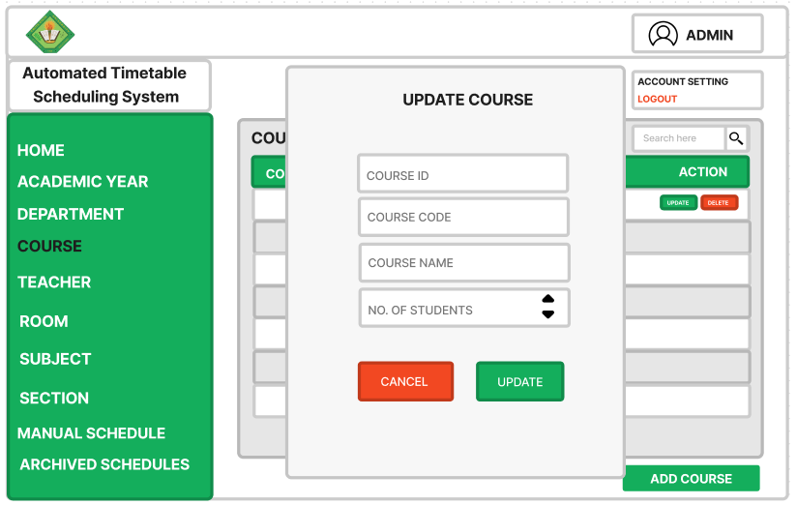
UPDATE COURSE PAGE

Slide 45
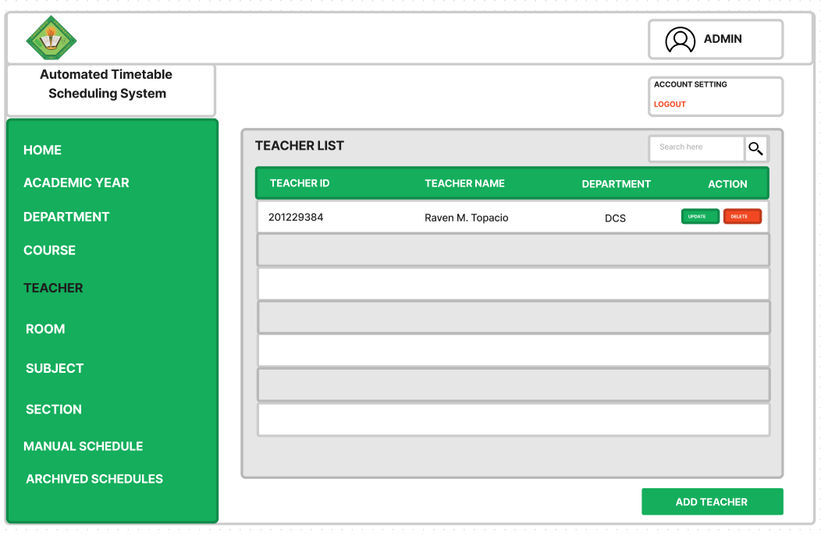
TEACHER LIST PAGE

Slide 46
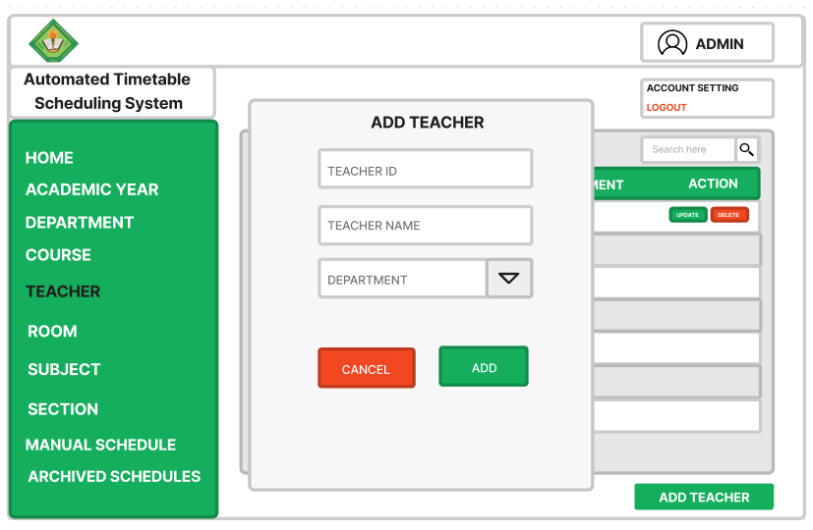
ADD TEACHER LIST PAGE

Slide 47
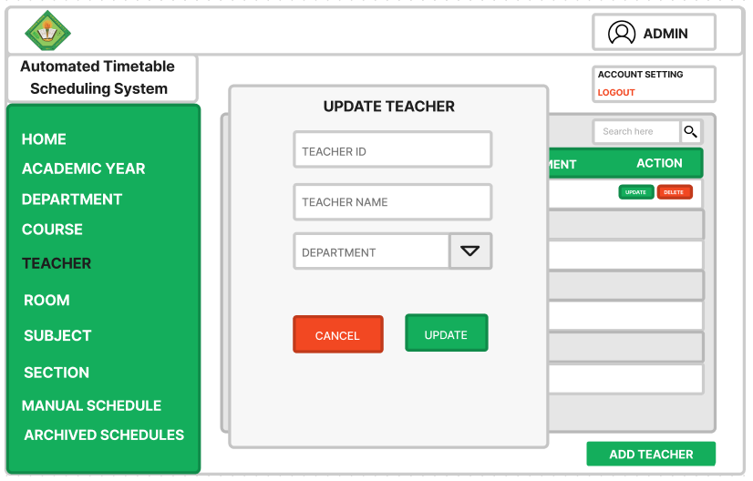
UPDATE TEACHER PAGE

Slide 48
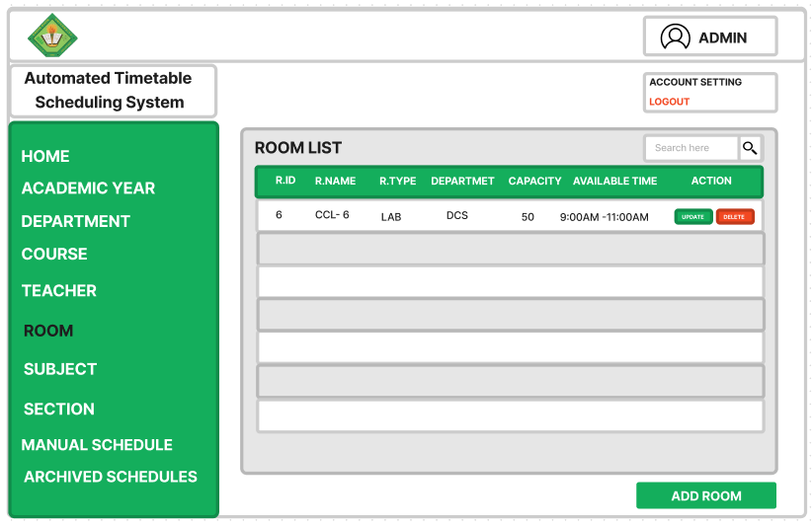
ROOM PAGE

Slide 49
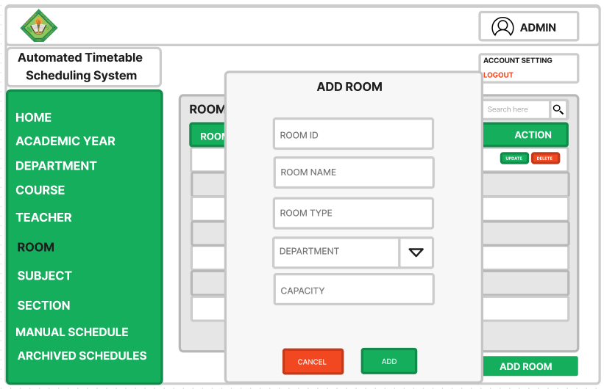
ADD ROOM PAGE

Slide 50
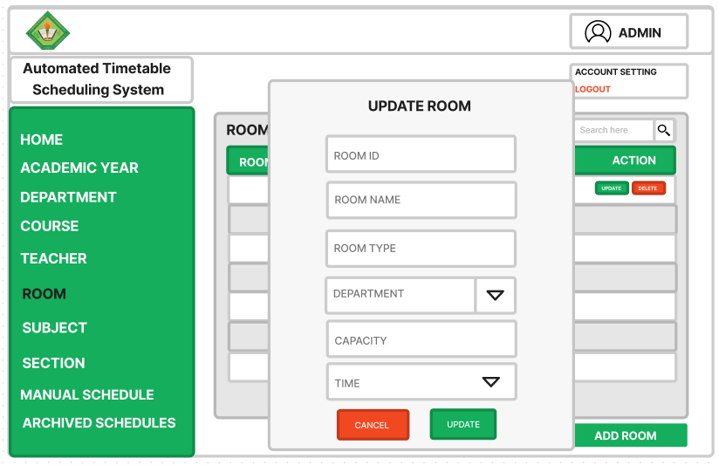
UPDATE ROOM PAGE

Slide 51
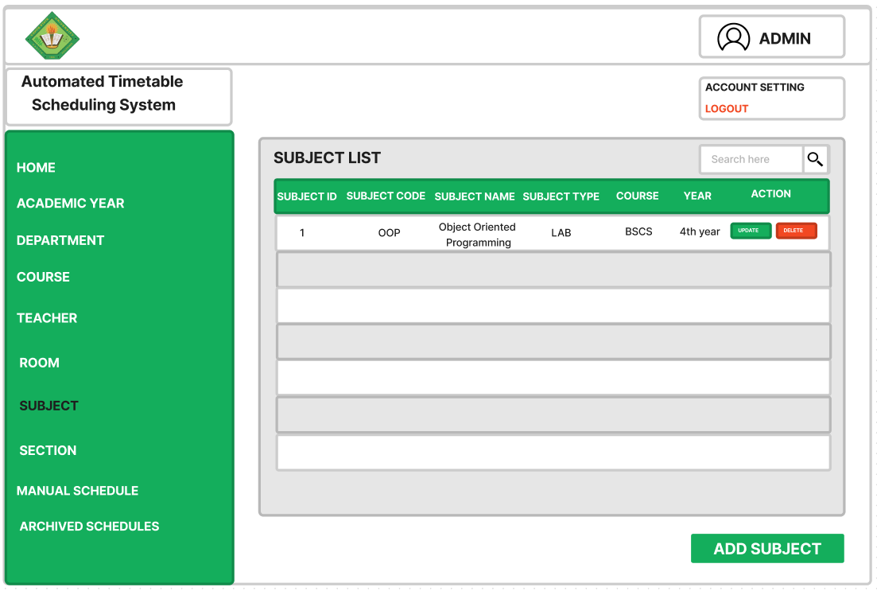
SUBJECT LIST PAGE

Slide 52
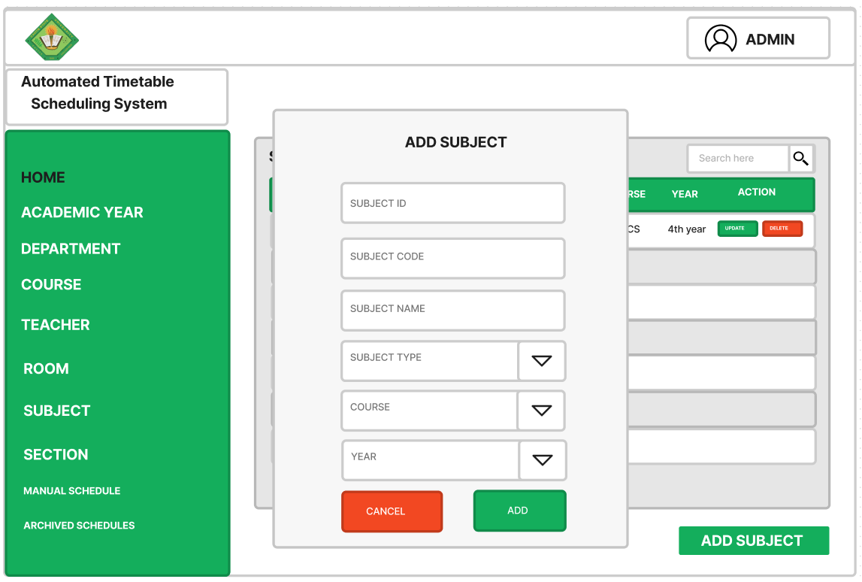
ADD SUBJECT PAGE

Slide 53

UPDATE SUBJECT PAGE

Slide 54
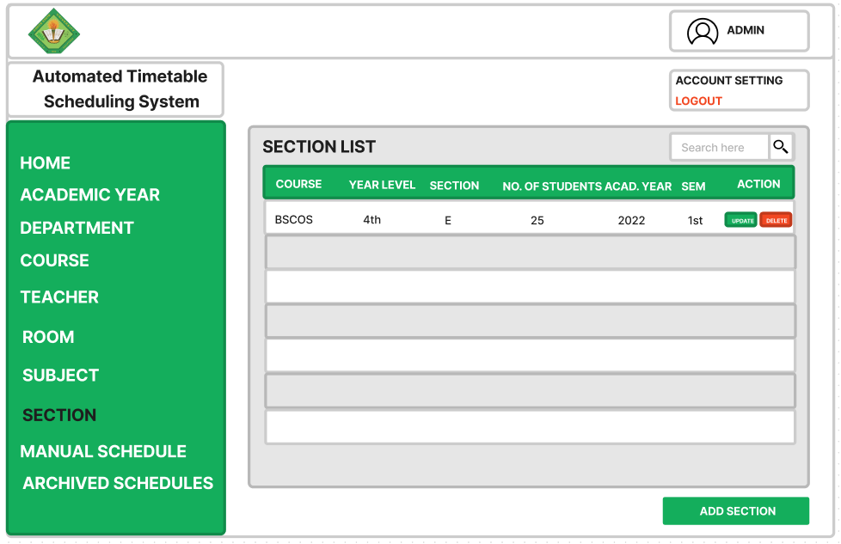
SECTION LIST PAGE

Slide 55
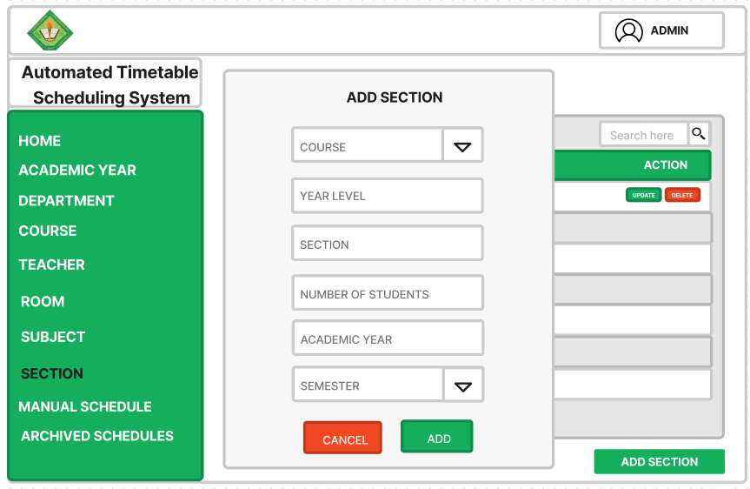
ADD SECTION PAGE

Slide 56
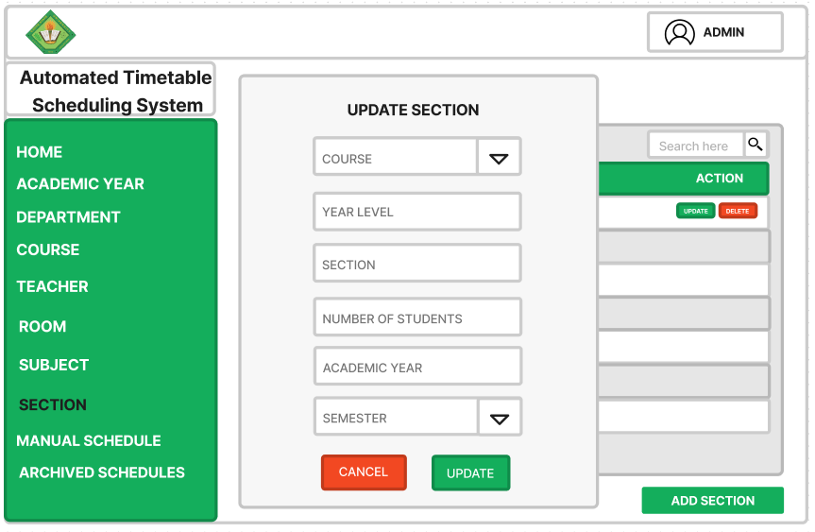
UPDATE SECTION PAGE

Slide 57
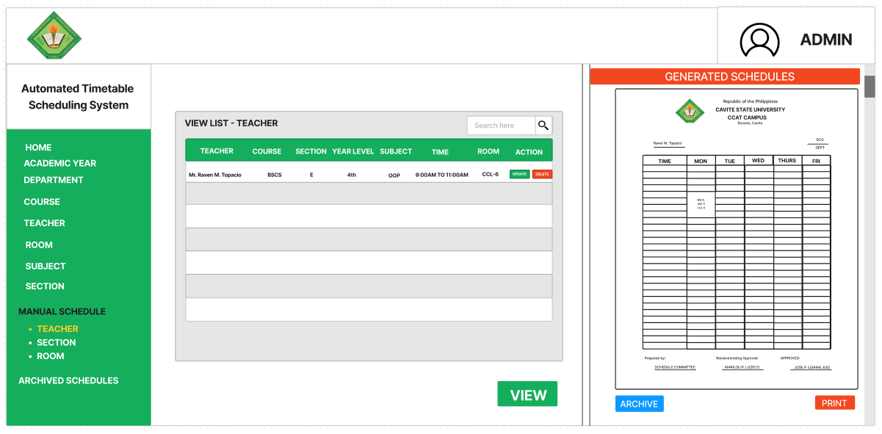
VIEW GENERATED SCHEDULE FOR TEACHER PAGE

Slide 58
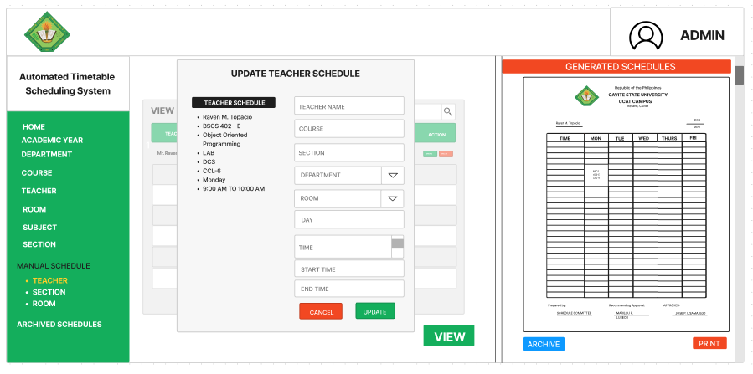
LOGIN PAGE
UPDATE TEACHER SCHEDULE PAGE

Slide 59
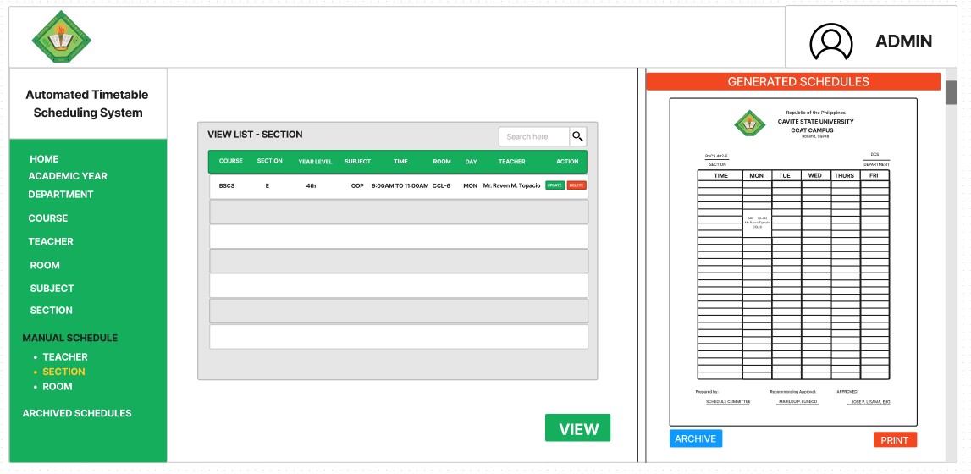
LOGIN PAGE
VIEW GENERATED SCHEDULE FOR STUDENT PAGE

Slide 60
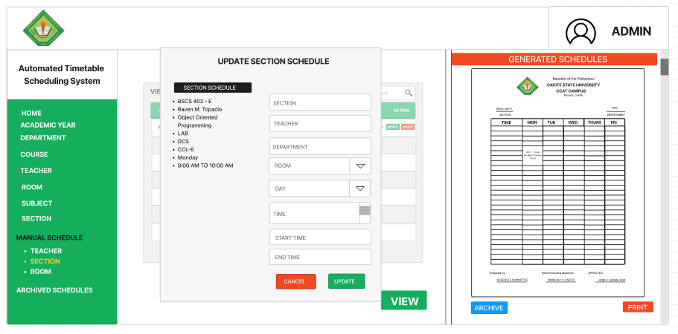
LOGIN PAGE
UPDATE STUDENT SCHEDULE PAGE

Slide 61
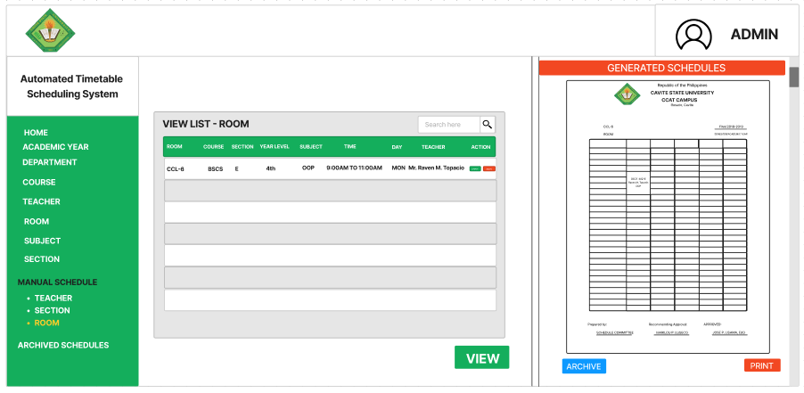
VIEW GENERATED SCHEDULE FOR ROOM PAGE

Slide 62
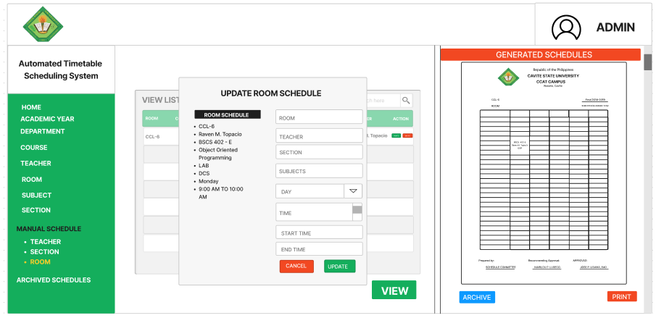
LOGIN PAGE
UPDATE ROOM SCHEDULE PAGE

Slide 63
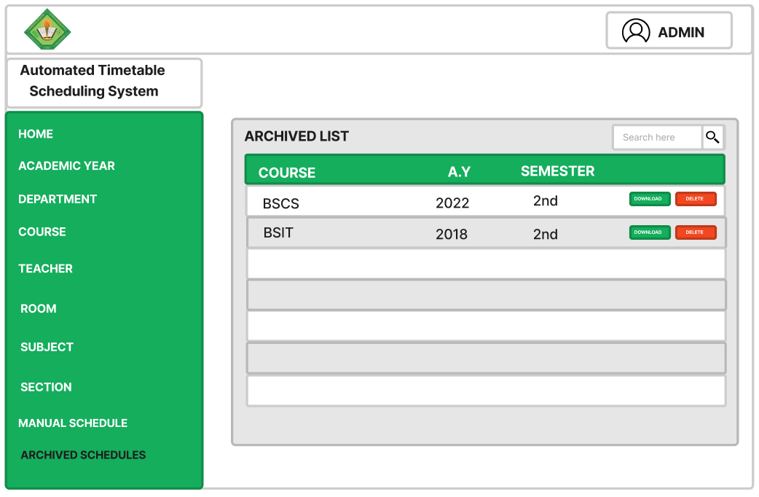
ARCHIVE SCHEDULE LIST PAGE

Slide 64

TESTING AND EVALUATION

Slide 65


Reliability
Functionality

Slide 66
Test Case
TEST CASE ID | OBJECTIVE | EXPECTED RESULTS | ACTUAL RESULTS | NUMBER OF DEBUGGED
T-001 | Test the login module | 3 failed login attempts should be blocked by the system. | 3 failed login attempts were blocked by the system. | 1

Slide 67
EVALUATORS DESCRIPTION

Slide 68
EVALUATORS DESCRIPTION
Evaluators | Number of Evaluators
Web Developers | 5
Faculty Members | 25
Students | 20

Slide 69
DESCRIPTIVE INTERPRETATION OF TOTAL SCORE

Slide 70
DESCRIPTIVE INTERPRETATION OF TOTAL SCORE
SCORE | INTERPRETATION
4.51 -5.00 3.51 - 4.50 2.51 - 2.50 1.51 - 2.50 1.00 - 1.50 | Excellent Very Satisfactory Satisfactory Unsatisfactory Needs Improvement

Slide 71

THANK YOU!

